Slide 1
Predicting lake hypolimnitic characteristics

Slide 2
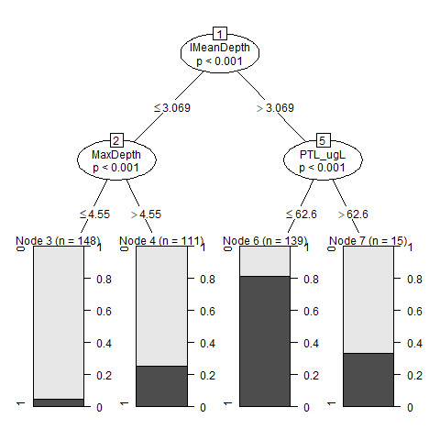
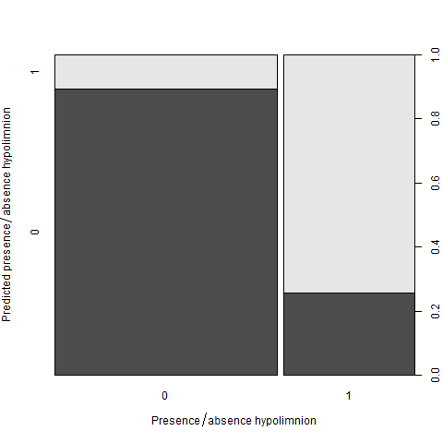
Presence/absence hypolimnion – machine learning

Slide 3
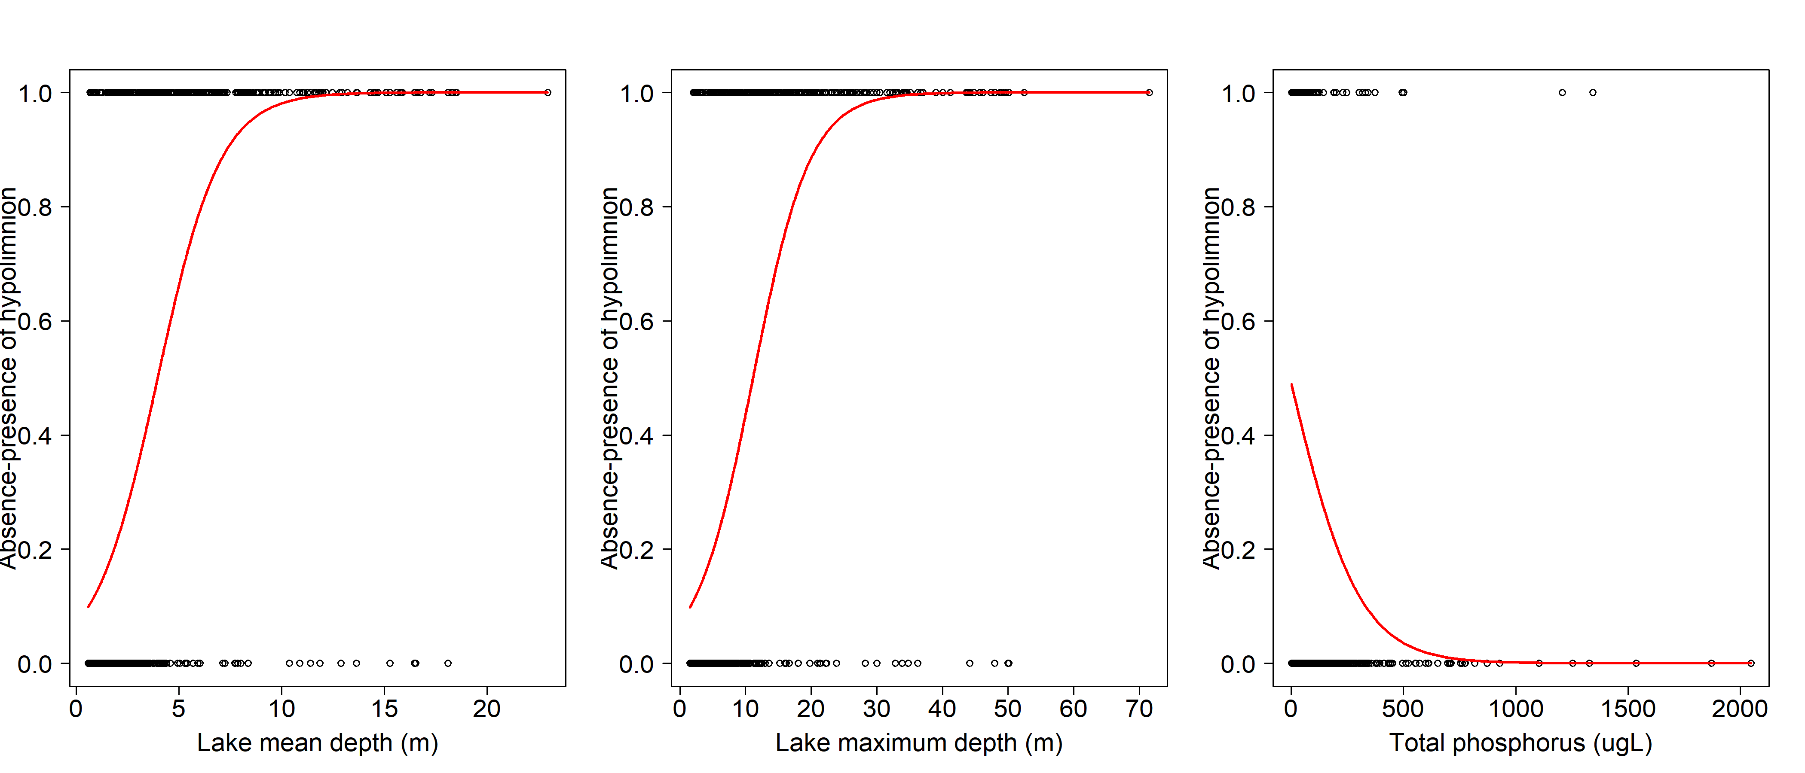
Presence/absence hypolimnion – logistic regression
AIC = 957
AIC = 962,4
AIC = 1323

Slide 4
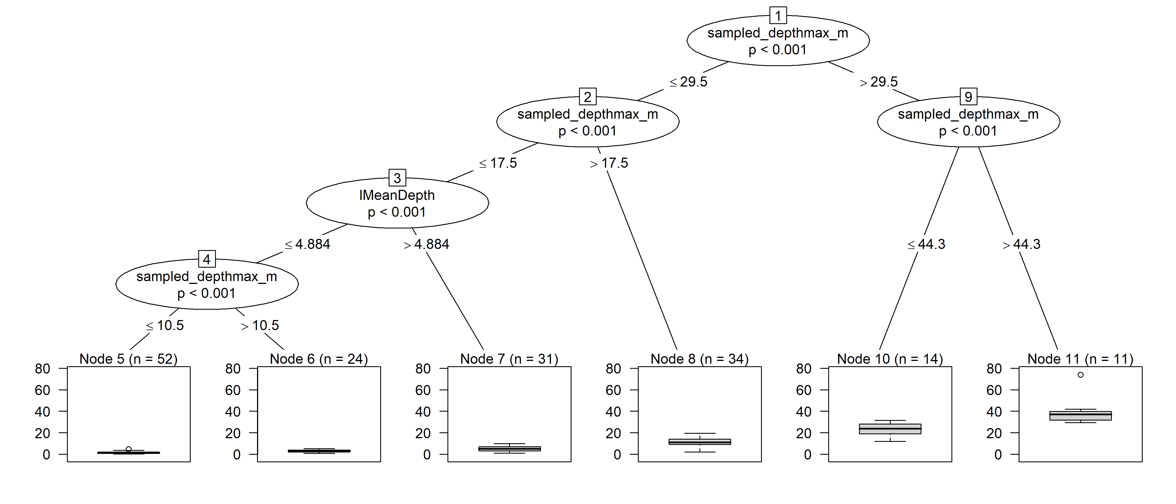
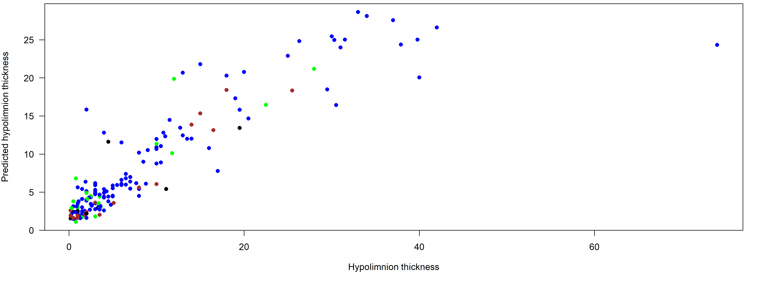
Hypolimnion thickness – machine learning
Notes:
L’effet profondeur est extrême

Slide 5
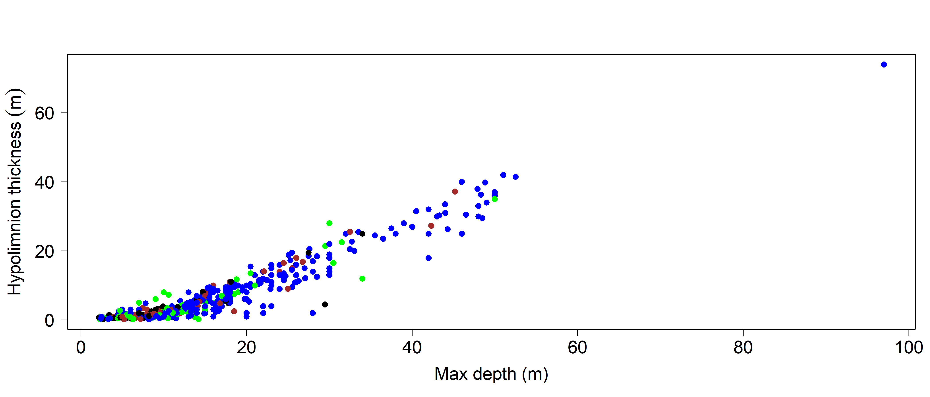
Hypolimnion thickness – regression

Slide 6
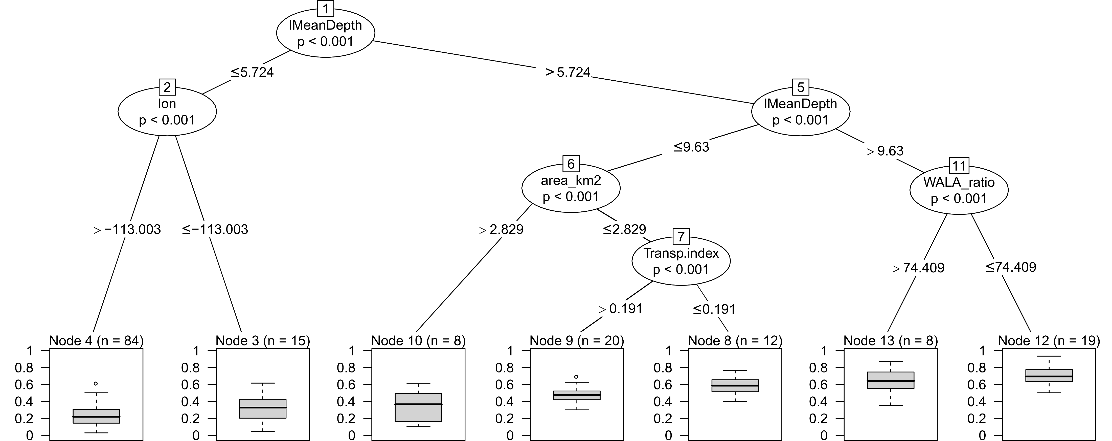
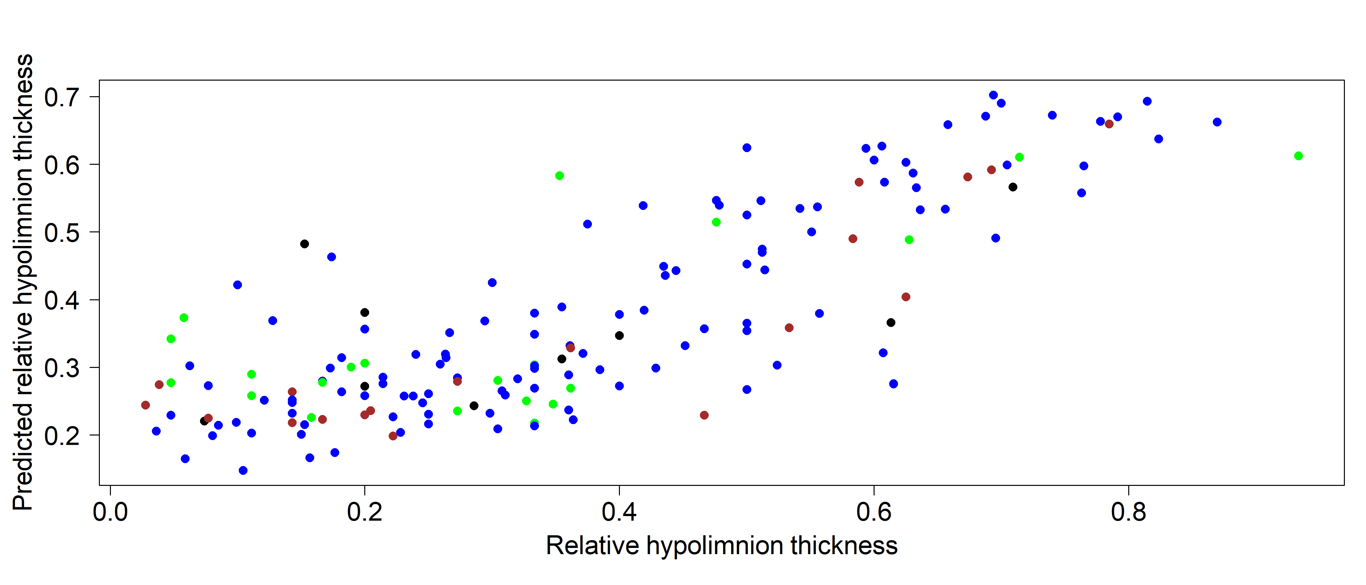
Relative hypolimnion thickness – machine learning
Notes:
En utilisant des données transformées (log, etc), la seule différence est Trnasp.index -> Color_PCU

Slide 7
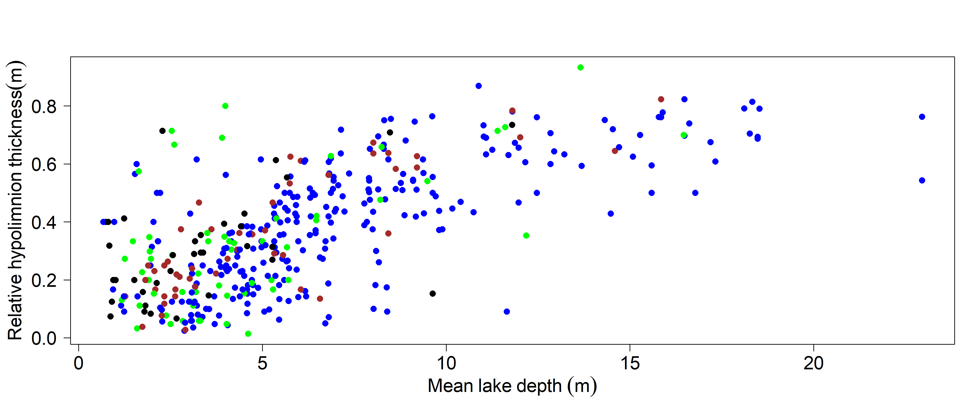
Relative hypolimnion thickness – regression

Slide 8
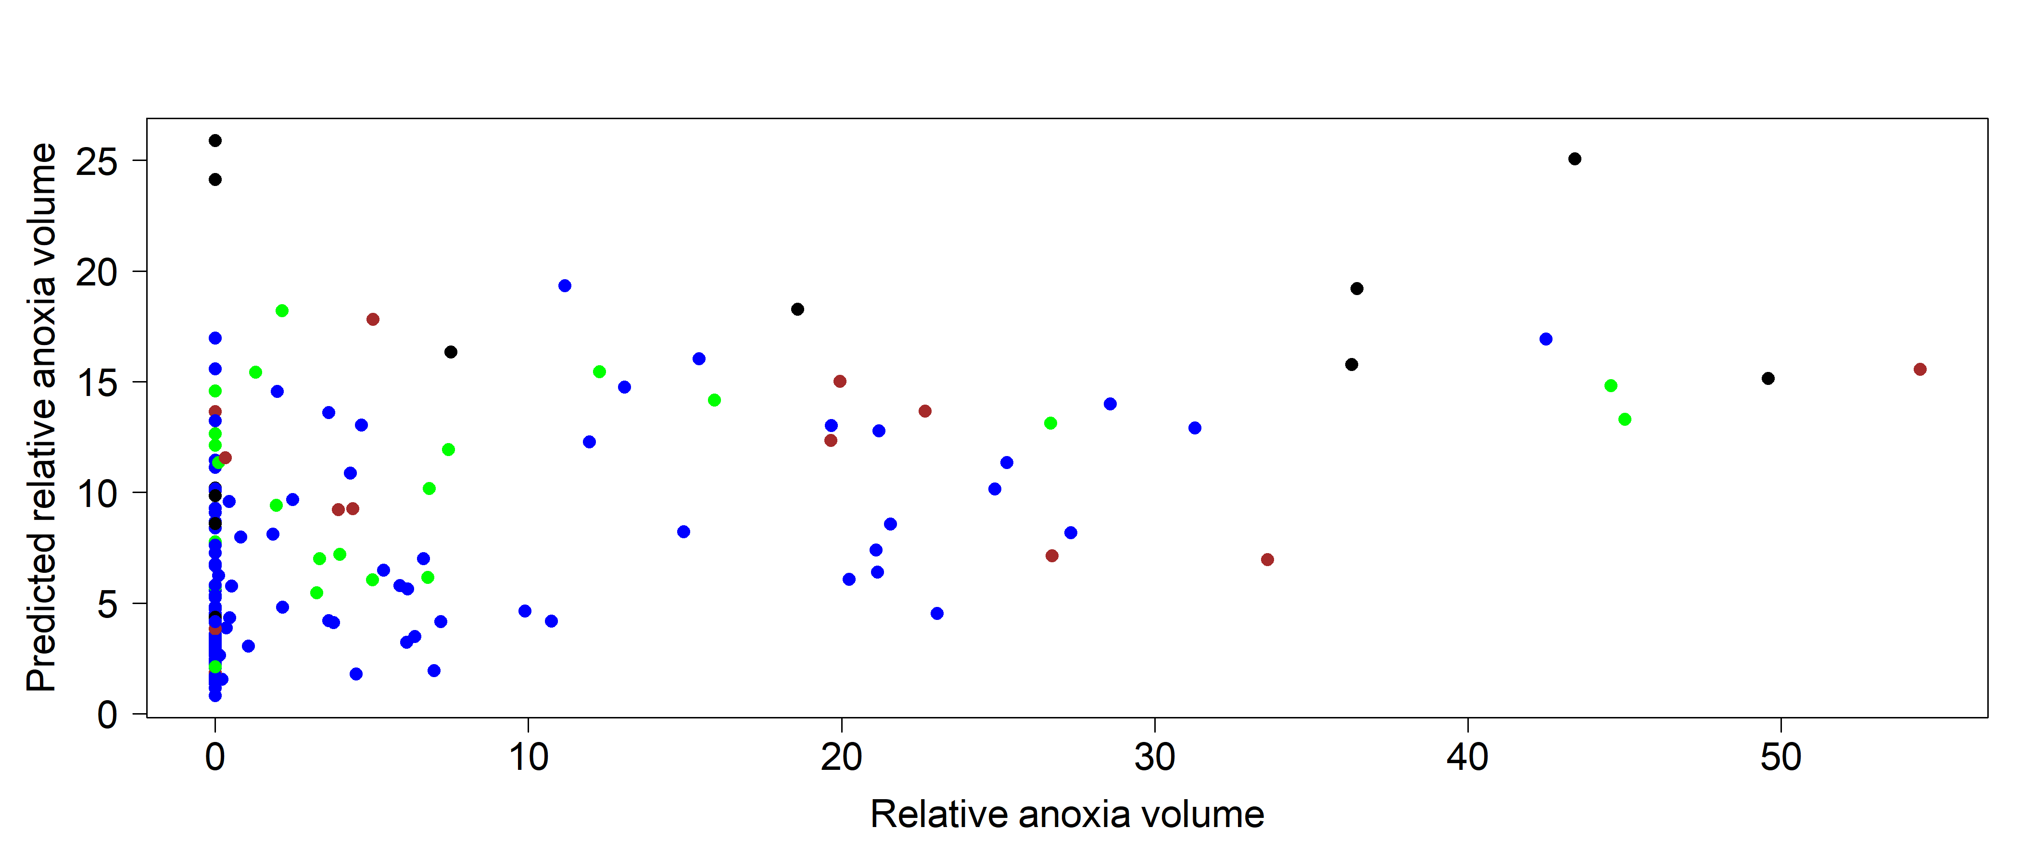
Relative anoxia volume (<0.5mg/L) – machine learning

Slide 9
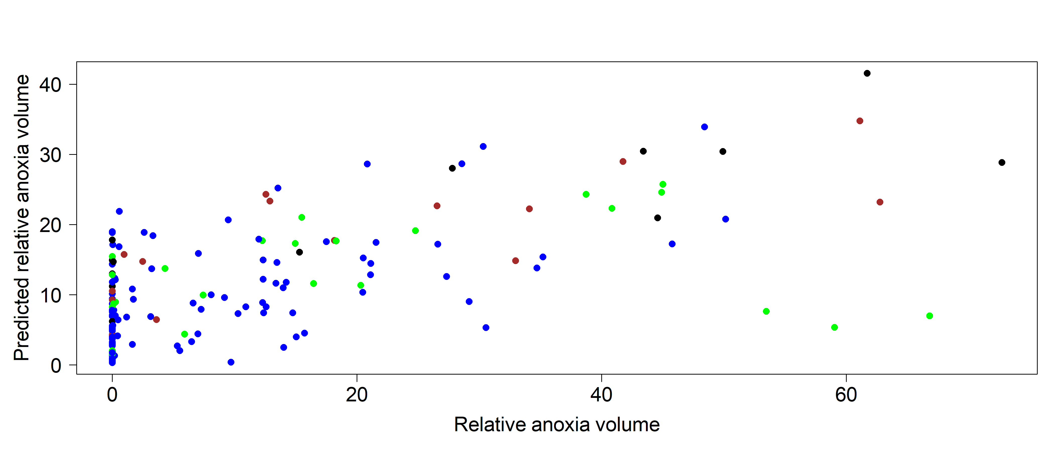
Relative hypoxia volume – machine learning

Slide 10
This model does not work (SEM wants Zmean ~Chla to improve the model, which makes no sense)
Zmax (x2)
Zmean (y1)
Secchi (x1)
Hypolimnion (z1)

Slide 11
This model does not work (SEM wants Zmean ~Chla to improve the model, which makes no sense)
TP (x1)
Chla (y1)
Zmean (x3)
Secchi (y2)
Hypolimnion (z1)
Notes:
dat = BF0712[,c(6,8,10,17,20,21)]
#x1 = TP ; y1 = chla ; y2 = secchi; x2 = Zmax ; y3 = Zmean ; z = Binhypo
colnames(dat) = c("y1", "x1", "y2", "y3", "x2", "z1")
attach(dat)
par(mfrow=c(2,3))
qqnorm(log(y1+1),main = 'y1')
qqline(log(y1))
qqnorm(log(x1),main = 'x1')
qqline(log(x1))
qqnorm(log(y2),main = 'y2')
qqline(log(y2))
qqnorm(log(y3),main = 'y3')
qqline(log(y3))
qqnorm(log(x2),main = 'x2')
qqline(log(x2))
qqnorm(z1,main = 'z1')
qqline(z1)
dat[,1] = log(dat[,1]+1)
dat[,c(2,3)] = log(dat[,c(2,3)])
dat[,c(4,5)] = log(dat[,c(4,5)])
dat[,6] = ordered(dat[,6])
### Model 1
# Step 1: Specify model
#x1 = TP ; y1 = chla ; y2 = secchi; x2 = Zmax ; y3 = Zmean ; z = Binhypo
mod.1 <- "y1 ~ x1
y2 ~ y1
y3 ~ x2
z1 ~ y2 + y3 + x2"
# Step 2: Estimate model
mod.1.fit <- sem(mod.1, data=dat)
# Step 3: Extract results
summary(mod.1.fit)
# The p-value is very significant: the fit of the model is very poor.
# We need to re-evaluate our hypotheses
# Request Modification Indices
modindices(mod.1.fit) #Requires to add Secchi ~ Zmean
### Model 2
#Step 1: Specify model
mod.2 <- "y1 ~ x1
y2 ~ y1
y2 ~ y3
y3 ~ x2
z1 ~ y2 + y3 + x2"
# Step 2: Estimate model
mod.2.fit <- sem(mod.2, data=dat)
# Step 3: Extract results
summary(mod.2.fit, rsq=T, standardized=T)
# Request Modification Indices
modindices(mod.2.fit) #Secchi ~ TP
### Model 3
#Step 1: Specify model
mod.3 <- "y1 ~ x1
y2 ~ x1 + y1 + y3
y3 ~ x2
z1 ~ y2 + y3 + x2"
# Step 2: Estimate model
mod.3.fit <- sem(mod.3, data=dat)
# Step 3: Extract results
summary(mod.3.fit, rsq=T, standardized=T)
# Request Modification Indices
modindices(mod.3.fit) #Secchi ~ TP

Slide 12
TP (x1)
Chla (y1)
Zmax (x2)
Zmean (y4)
Secchi (y2)
Transp.index (y3)
Hypolimnion (z1)
Notes:
dat = BF0712[,c(6,8,10,16,17,20,21)]
#x1 = TP ; y1 = chla ; y2 = secchi; x2 = Zmax ; y3 = Transp.index ; y4 = Zmean ; z = Binhypo
colnames(dat) = c("y1", "x1", "y2", "y3", "y4", "x2", "z1")
attach(dat)
par(mfrow=c(2,3))
qqnorm(log(y1+1),main = 'y1')
qqline(log(y1))
qqnorm(log(x1),main = 'x1')
qqline(log(x1))
qqnorm(log(y2),main = 'y2')
qqline(log(y2))
qqnorm(y3,main = 'y3')
qqline(y3)
qqnorm(log(y4),main = 'y4')
qqline(log(y4))
qqnorm(log(x2),main = 'x2')
qqline(log(x2))
qqnorm(z1,main = 'z1')
qqline(z1)
dat[,1] = log(dat[,1]+1)
dat[,c(2,3,5,6)] = log(dat[,c(2,3,5,6)])
dat[,7] = ordered(dat[,7])
### Model 1
# Step 1: Specify model
#x1 = TP ; y1 = chla ; y2 = secchi; x2 = Zmax ; y3 = Zmean ; z = Binhypo
mod.1 <- "y1 ~ x1
y2 ~ y1 + x1
y3 ~ y2 + x2
y4 ~ x2
z1 ~ y3 + y4 + x2"
# Step 2: Estimate model
mod.1.fit <- sem(mod.1, data=dat)
# Step 3: Extract results
summary(mod.1.fit)
# The p-value is very significant: the fit of the model is very poor.
# We need to re-evaluate our hypotheses
# Request Modification Indices
modindices(mod.1.fit) #Requires to add Secchi ~ Zmean
### Model 2
#Step 1: Specify model
mod.2 <- "y1 ~ x1
y2 ~ y1 + x1 + y4
y3 ~ y2 + x2
y4 ~ x2
z1 ~ y3 + y4 + x2"
# Step 2: Estimate model
mod.2.fit <- sem(mod.2, data=dat)
# Step 3: Extract results
summary(mod.2.fit, rsq=T, standardized=T)
# Request Modification Indices
modindices(mod.2.fit) #Secchi ~ TP

